Slide 1


Mobile and Wireless Networks Smart Plant Watering System
College of computer science and information technology

Slide 2
Group members
Ali aldandan 222425258
Ali alsuliah 222407097

Slide 3
Table pf contents
4
Introduction
5
Objective of the project
6
System Components
7
How It Works
8
conclusion

Slide 4


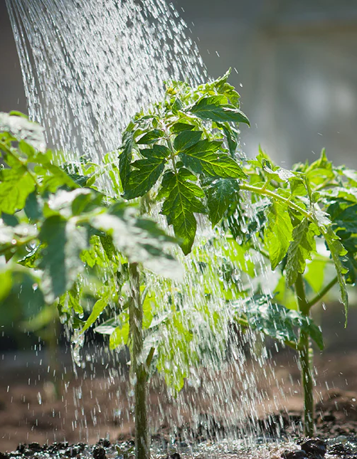
Introduction
This project focuses on creating a smart plant watering system that can operate automatically or manually. By using ESP8266, soil moisture sensors, and a water level sensor, the system ensures that plants receive the right amount of water without wasting resources. The Blynk app allows users to monitor and control the system remotely, making it an efficient and convenient solution for plant care.

Slide 5

Objective of the project:
This project aims to create a smart system for automatically and manually watering plants ,The system monitors soil moisture and water tank levels, reducing effort and preventing water waste. Using IoT technology for real-time control and monitoring through the Blynk app.

Slide 6
System Components :
ESP8266: Controls and processes data.
Soil Moisture Sensor: Measures soil dryness.
Water Level Sensor: Checks water availability.
Water Pump: Distributes water to plants.
Blynk App: Allows remote monitoring and control.

Slide 7
How it works
- The soil moisture sensor detects the soil's dryness.
1
- The water level sensor measures water in the tank.
2
- ESP8266 processes data : Automatically activates the pump if the soil is dry .
3
- Users can also manually control the pump through the Blynk app.
4

Slide 8
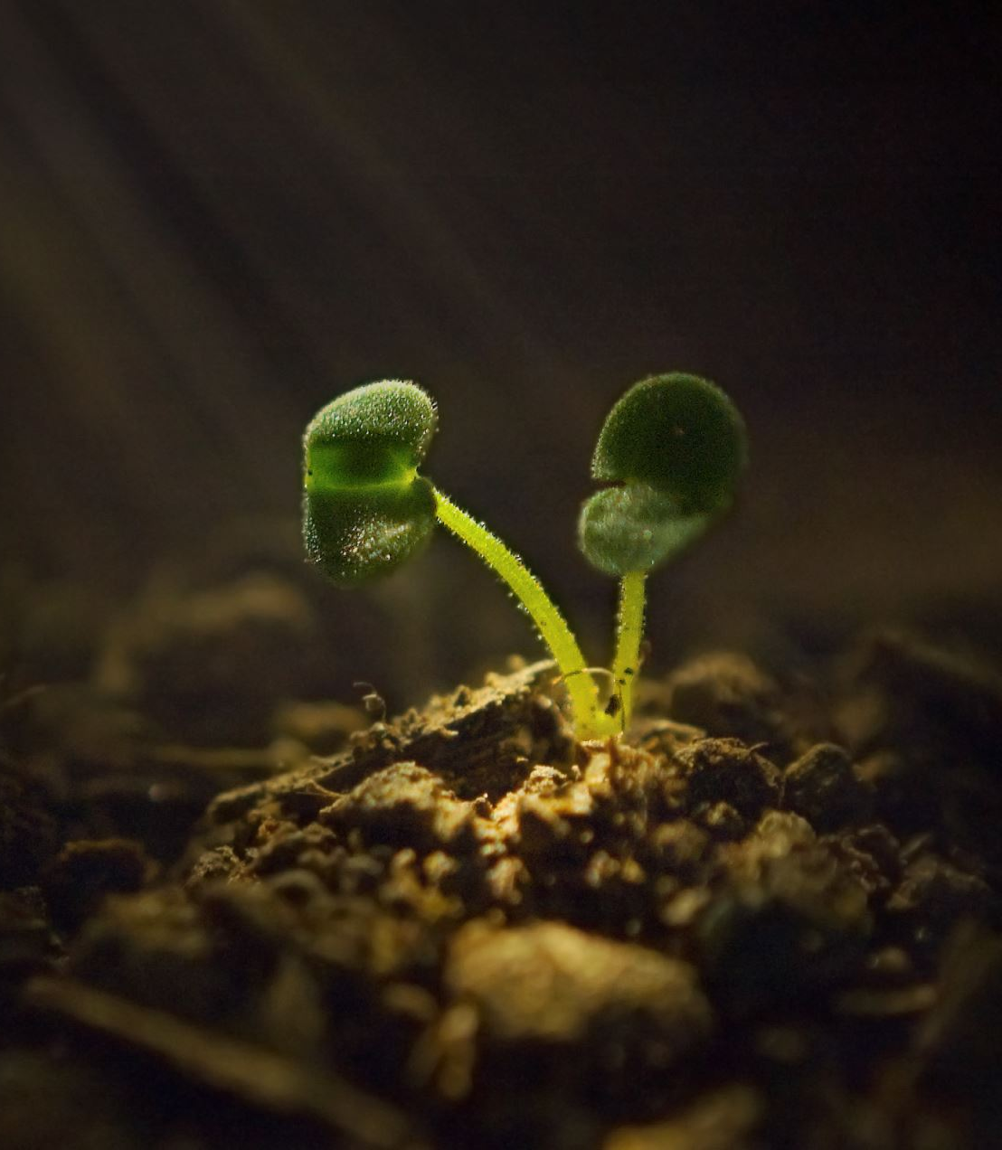
Conclusion
The automatic and manual plant watering system offers a practical solution for reducing water usage and saving time while ensuring plants remain healthy. With its smart integration of IoT components, it simplifies plant care, making it suitable for both home gardens and small-scale agricultural applications. This project demonstrates how technology can address everyday challenges effectively.

Slide 9



Thanks for your attention
The end

